Slide 1
Chapter 16 – Transport in Plants

Slide 2
16.1 Structure of the Plant Transport System
You should be able to:
■ describe the structure of xylem vessels, sieve tubes and companion cells;
■ understand the function of phloem in the transport system of plants; and
■ explain how the structure of xylem vessels suits them for their function.

Slide 3
16.1 Structure of the Plant Transport System
A plant consists of three main organs, the leaves, stems and roots. The leaves manufacture sugars from photosynthesis, and the roots absorb water and minerals from the soil. The roots, stems and leaves can be grouped into 3 tissue systems.
  Ground tissue system – consists of packing and supportive tissue which makes up the bulk of the plant.
  Vascular tissue system – consists of xylem and phloem tissue arranged as vascular bundles. They transport water and nutrients between organs and also provide mechanical support.
  Dermal tissue system – consists of epidermal tissue which forms a protective outer covering of plant organs.

Slide 4
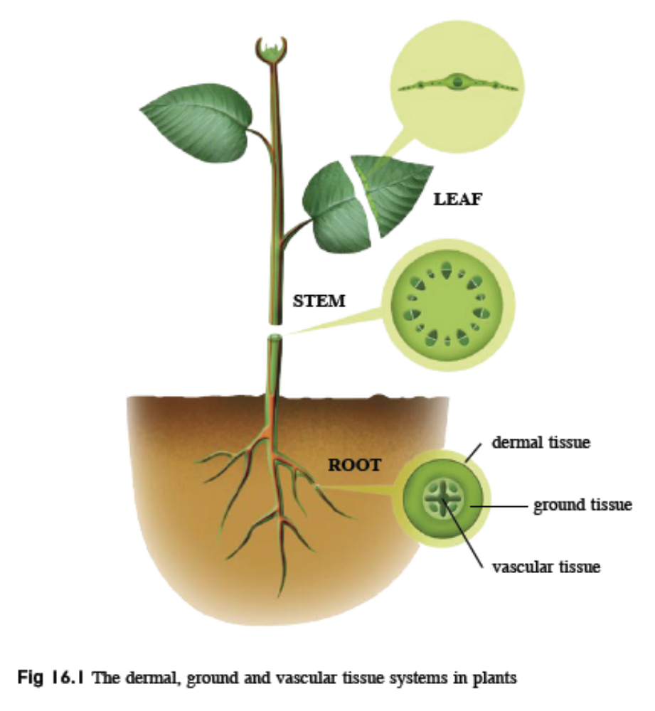
16.1 Structure of the Plant Transport System

Slide 5
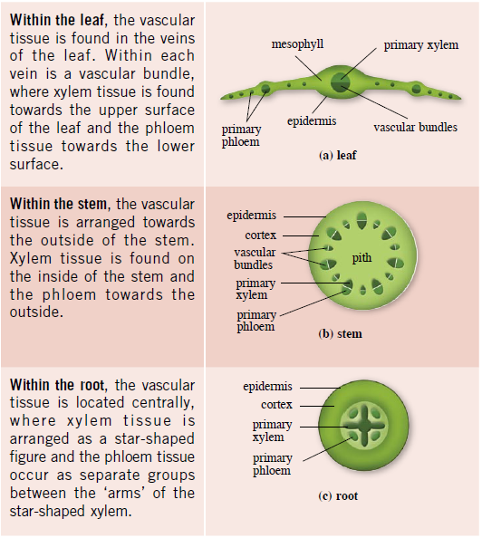
16.1 Structure of the Plant Transport System
Distribution of vascular tissue in a plant

Slide 6
16.1 Structure of the Plant Transport System
Structure and Function of Phloem
Phloem transports organic nutrients such as sugar and amino acids from leaves and storage organs to other parts of the plant.
Phloem tissue is composed of a few types of cells called companion cells, sieve tube elements or sieve tube members and phloem fibres as well as unspecialised phloem parenchyma.
Sieve tube elements are elongated cells joined end to end to form a column. Walls between 2 cells are perforated, forming sieve pores.
As they lack the structures needed to carry out many metabolic processes, they rely on the companion cells, lying close to them, for their survival.

Slide 7
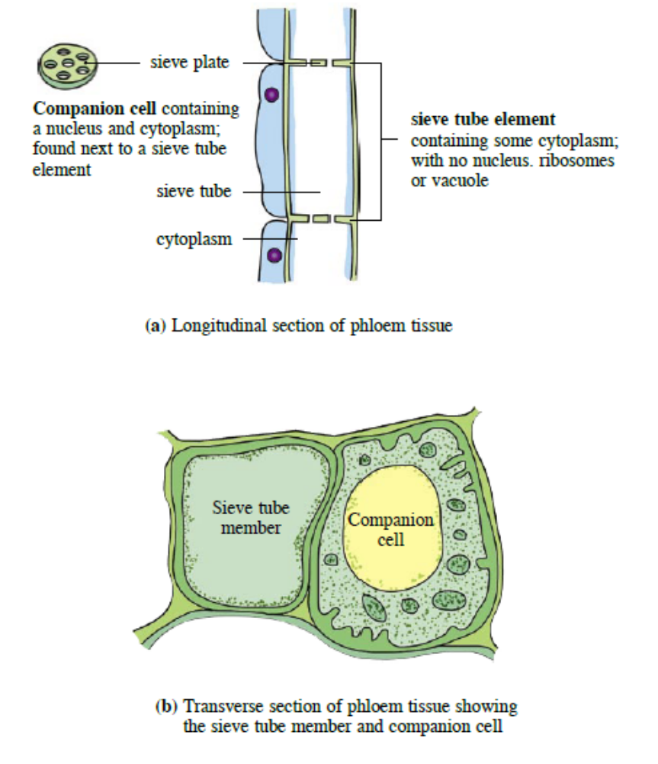
16.1 Structure of the Plant Transport System

Slide 8
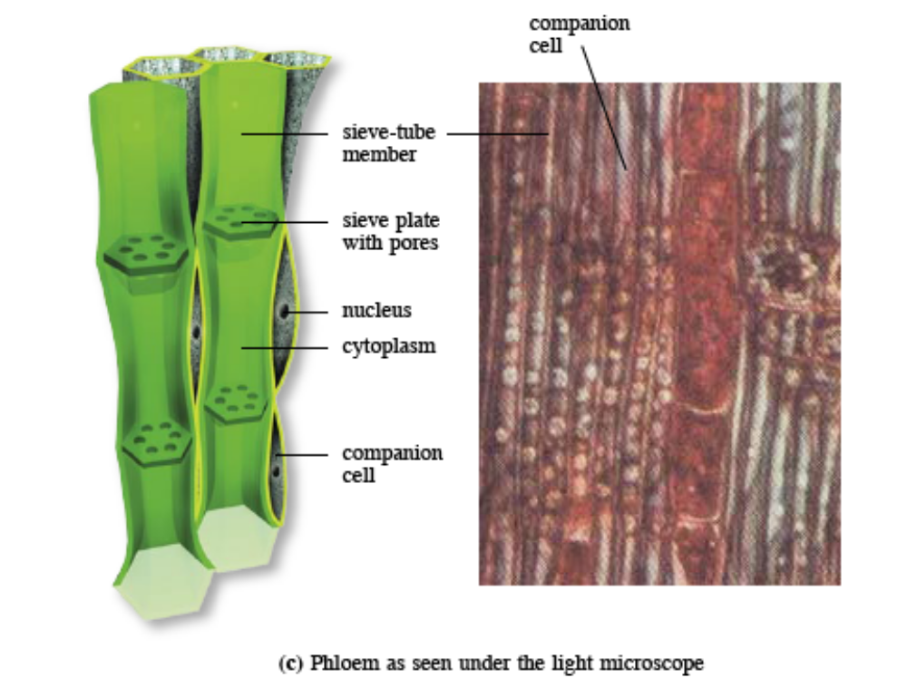
16.1 Structure of the Plant Transport System

Slide 9
16.1 Structure of the Plant Transport System
How is the phloem adapted for its function?
The sieve tube elements are elongated and arranged to form a continuous column.
As the sieve tube elements have little protoplasm, they are more hollow and so have less resistance to the flow of liquid within them.
The presence of sieve plates allows liquid to flow through the sieve tube elements easily. Sieve plates have holes called sieve pores.
The companion cells have many mitochondria to produce energy (ATP) needed for the transportation of organic nutrients.

Slide 10
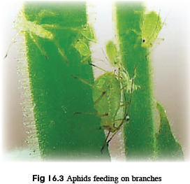
16.1 Structure of the Plant Transport System
What evidence shows translocation occurs in the
phloem?
When a plant is provided with radioactive carbon dioxide, sugars formed during photosynthesis will contain radioactive carbon, which is found in the phloem.
Aphids feed on plant juices and they penetrate the phloem with their mouthparts during their feeding. It has shown, by analysing these aphids, that they contain sucrose and amino acids. Cutting the stylet causes the sap to continue to come out, showing there is pressure inside.

Slide 11
16.1 Structure of the Plant Transport System
Structure and Function of Xylem
Xylem transports water and dissolved minerals from the roots to the other parts of the plant; it provides mechanical support to the plant.
Xylem tissue consists of xylem vessels, tracheids, xylem fibres and xylem parenchyma.

Slide 12
16.1 Structure of the Plant Transport System
Xylem vessels are elongated cells arranged end to end. As the cells develop, their cytoplasm and end walls break down, forming perforation plates, eventually a continuous hollow tube.
Their cell walls become impregnated with lignin, which causes the cells to die and become vessel elements.
Lignin may be deposited in various patterns e.g. annular, spiral and pitted thickening except in regions called pits.
Xylem tracheids are thinner than xylem vessels and have tapering ends but no perforation plates.
Xylem fibres have lignified cell walls while xylem parenchyma act as packing tissue around other components of xylem. They have thick cell walls, providing support as turgid cells.

Slide 13
16.1 Structure of the Plant Transport System
How is the xylem adapted for its function?
The cells are elongated and arranged to form a continuous column.
As the cell develops, it loses its cell contents and forms a hollow tube, allowing easy flow of water with no resistance. There is also no barrier for water to flow from one cell to the next as the end walls have broken down.
Cell walls are thickened with lignin, preventing collapse of the xylem vessel under any tension created by the transpiration pull.
There are pits in the lignified walls which allow lateral movement of water.
The lumen (central space within) of the xylem vessels is narrow, which causes water to travel up by capillary action.

Slide 14
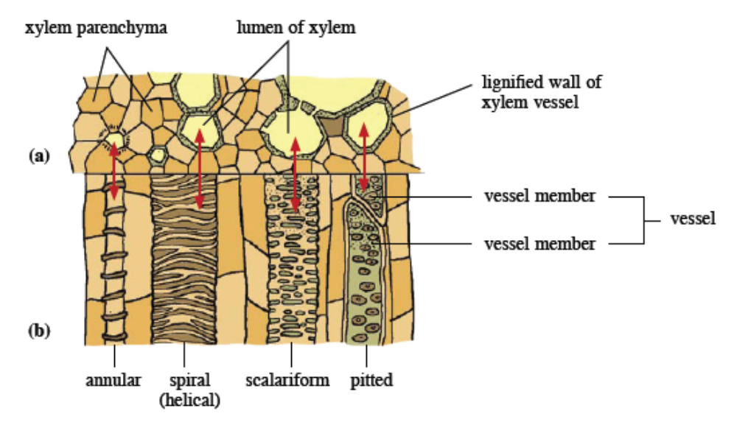
16.1 Structure of the Plant Transport System

Slide 15
16.2 Transport of Water through a Plant
You should be able to:
■ describe the processes involved in transpiration;
■ demonstrate the effect of external factors on transpiration; and
■ discuss adaptation in plants to conserve water.

Slide 16
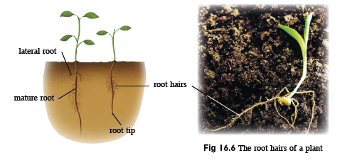
16.2 Transport of water through a Plant
Uptake of water through the roots
Absorption of water and minerals takes place through the root hairs.
The root hair cell has a large surface area to volume ratio which is due to its long and narrow shape.
This increases the rate of absorption of water and mineral salts.

Slide 17
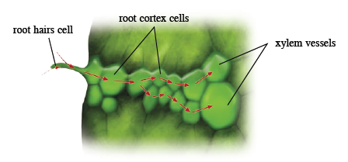
16.2 Transport of water through a Plant
Water enters the root hair cells by osmosis, as its cell sap has a lower water concentration than soil solution. Water then passes from cell to cell by osmosis across the root cortex, down a water potential gradient, until it enters the xylem vessels.
Minerals are absorbed into the root hair cells by diffusion or active transport

Slide 18
16.2 Transport of water through a Plant
Movement of Water up the Stem to the Leaves
Transpiration, which is the evaporation of water through the stomata of leaves, creates a pull from the roots upwards to the leaves as follows:
  In the leaves, water molecules leave the xylem vessels and move from cell to cell by osmosis along a water potential gradient.
  Water then evaporates into the air spaces in the leaf and diffuses through the stomata into the surrounding air.
  Water lost from the air spaces causes more water to evaporate from surrounding cells. Their water potential is lowered and water moves in from neighbouring cells by osmosis.
  Water is thus drawn from the xylem across the mesophyll cells down a water potential gradient, into the air spaces and out into the atmosphere. This is called the transpiration pull.

Slide 19
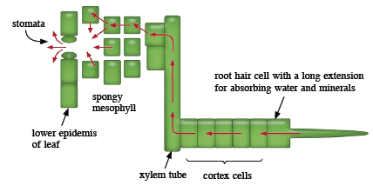
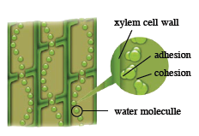
16.2 Transport of water through a Plant
What causes water to move up a xylem vessel?
Cohesion: forces of attraction between water molecules
Adhesion: forces of attraction between water molecules and walls of xylem vessels
These ensure water moves in a continuous column up the vessel.
The narrow lumen of the vessel also promotes movement up the xylem vessel under the effect of capillary action.

Slide 20
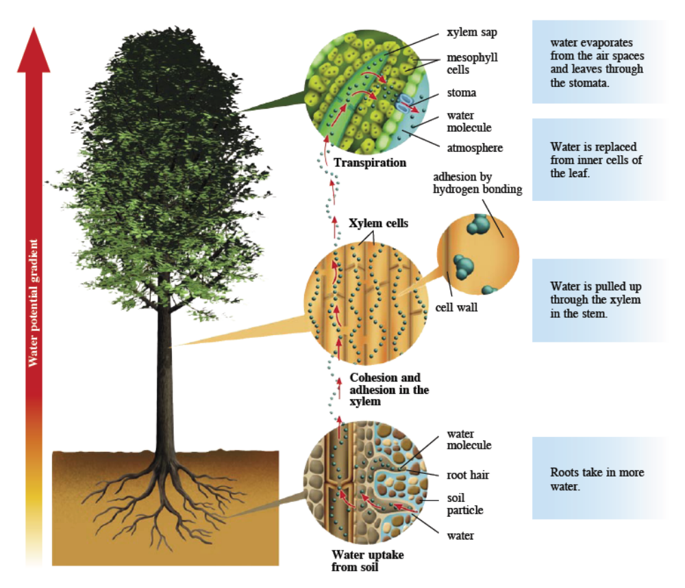
16.2 Transport of water through a Plant

Slide 21
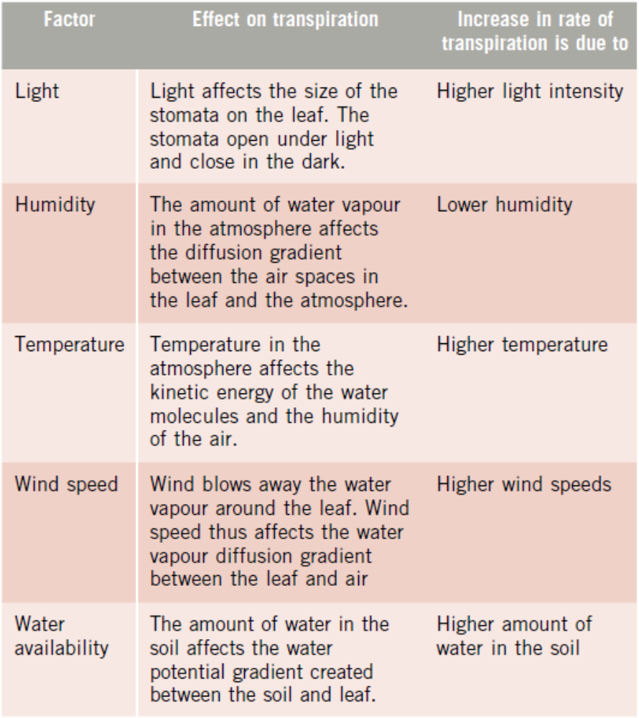
16.2 Transport of water through a Plant
Factors affecting Rate of Transpiration

Slide 22
16.2 Transport of water through a Plant
Excessive transpiration is harmful to the plant, but it is also important because:
  it creates a transpiration pull which carries water and minerals from the roots to the stems and leaves;
  water transported to the leaves is used for photosynthesis and it replaces water lost by the cell and keeps cells turgid;
  evaporation of water from the leaves has a cooling effect on the plant.

Slide 23
16.2 Transport of water through a Plant
Adaptations in Plants
Plants which live in extremely dry environments (xerophytes) have special adaptations to control their transpiration rate and conserve water:
  deep roots – reach water far underground
  shallow spreading roots – collect occasional rainfall
  leaves reduced to spines – reduce surface area for transpiration
  less stomata present on the leaves – reduce transpiration rate
  rolled leaves, leaf hairs and stomata sunk in pits – trap moist air, increasing humidity and slowing diffusion of water vapour from the stomata
  waxy leaf cuticle – impermeable to water
  stomata closed at midday when transpiration rate would be the highest
  storage of water in succulent tissues

Slide 24
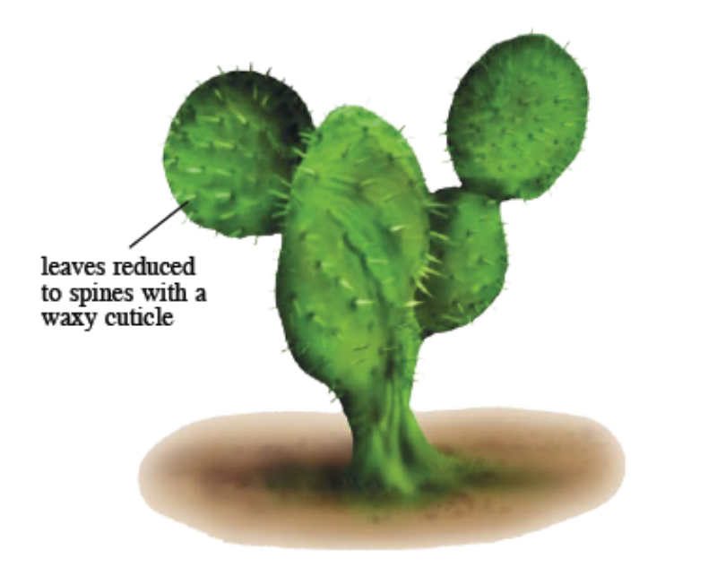
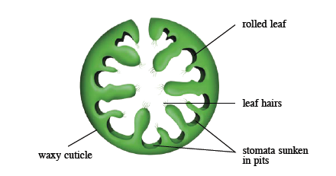
16.2 Transport of water through a Plant
Grooves in the leaves of the Marram grass contain sunken stomata and leaf hairs that trap a layer of air, thus reducing transpiration.
A cactus with reduced leaves

Slide 25
Key Concepts
Vascular tissue in plants consists of xylem and phloem. They are arranged differently in the roots, stem and leaves.
The phloem transports organic nutrients such as sugar and amino acids from leaves and storage organs to other parts of the plant.
Phloem tissue is composed of companion cells and sieve tube elements. As the sieve tube element lacks the cell structures needed to carry out many metabolic processes, they rely on the companion cells for their survival.
Sieve tube elements are arranged to form a continuous column. They have little protoplasm and have sieve plates containing pores so that there is less resistance to the flow of liquid within them.

Slide 26
Key Concepts
Xylem transports water and dissolved minerals from the roots to the other parts of the plant. It also provides mechanical support to the plant.
Xylem vessels and tracheids consist of elongated cells arranged end to end. The cells have no protoplasm and end walls to form a continuous hollow tube. Lignin is also deposited on the cell walls.
Xylem vessels form a continuous hollow tube which allows easy flow of water with no resistance. The lignified cell walls also prevent collapse of the xylem vessel.
Plants take in water by the roots. Water enters the root hair cells by osmosis before it enters the xylem vessels. Minerals are absorbed into the root hair cells by diffusion or active transport.

Slide 27
Key Concepts
Transpiration is the evaporation of water through the stomata of leaves. This creates a pull from the roots upwards to the leaves called the transpiration pull, which is the main force that transports water up the stem to the leaves.
Light, humidity, temperature, wind speed and water availability are factors affecting rate of transpiration.
Plants which live in extremely dry environments have special adaptations to control their transpiration rate and conserve water.

